Slide 1


FOG COMPUTING
Dr. Md. Sazzadur Rahman
Associate Professor
IIT-JU

Slide 2
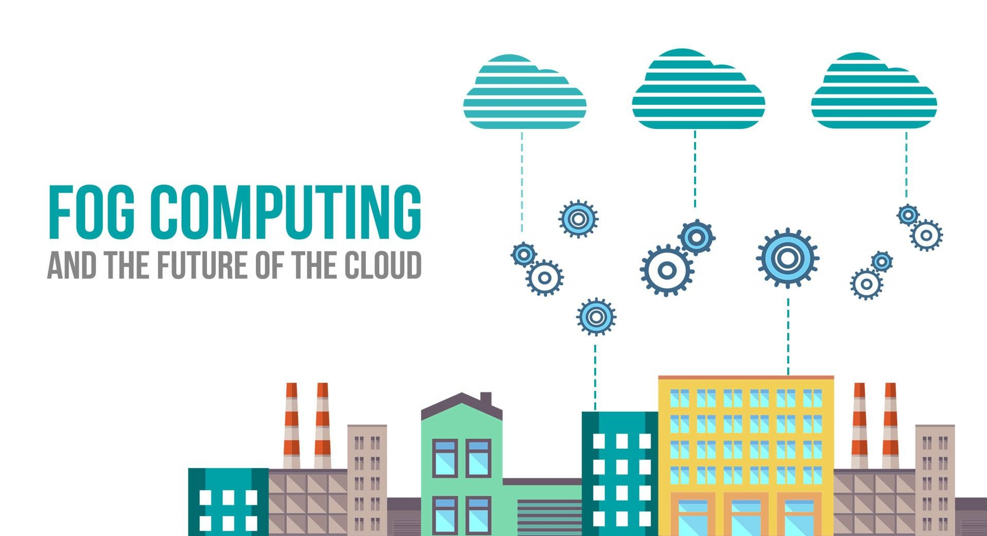


Slide 3
Table Of Content
Cloud Computing Limitation.
Fog Computing & Its Characteristics.
Fog VS. Cloud.
Fog Technology Architecture.
Case Study.
Further Applications.
Review Paper.
Summary & References.

Slide 4
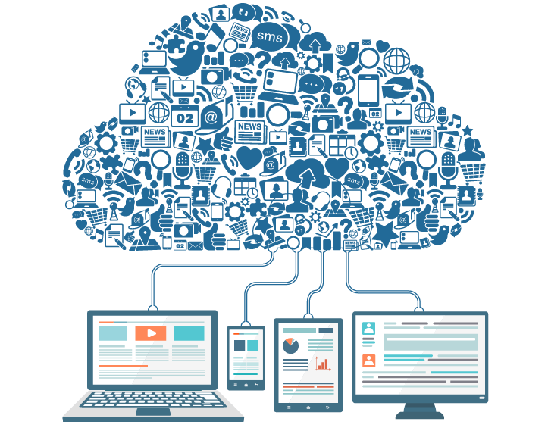
Existing Cloud Computing System
Cloud computing is a type of computing that relies on sharing computing resources rather than having local servers or personal devices to handle applications.

Slide 5
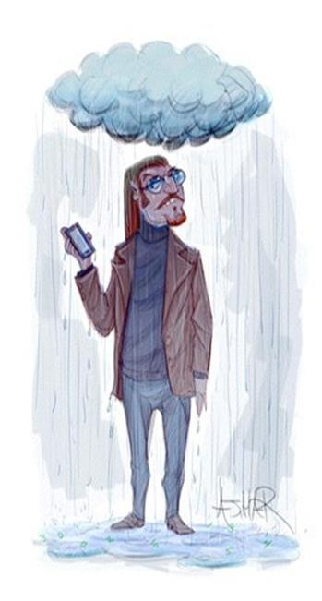
Cloud Computing Limitations
Not Always Connected:
Connectivity to the Cloud is a pre-requisite of cloud computing.
Some IoT systems need to work even if connection is temporarily unavailable.
Not Always Enough Bandwidth:
Cloud computing assumes that there is enough bandwidth to collect the data.
That can become an overly strong assumptions for Industrial IoT applications.
Cloud computing centralizes analytics:
Thus defining the lower bound reaction time of the system.
Some IoT applications won’t be able to wait for the data to get to the cloud, be analyzed and for insights to get back.
Security Shortcomings:
Existing data protection mechanisms in Cloud Computing such as encryption failed in securing the data from the attackers.

Slide 6
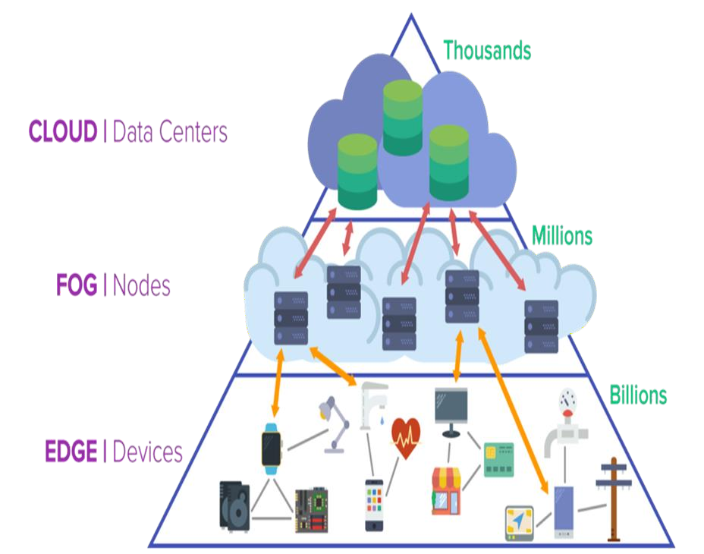
Fog Computing
Whereas the cloud is "up there" in the sky somewhere, distant and remote and deliberately abstracted.
The "fog" is close to the ground,
right where things are getting done.

Slide 7
Fog Computing
Fog computing (aka, Edge computing) is a paradigm that extends Cloud computing and services to the edge of the network.
Fog computing places processes and resources at the edge of the cloud, often on network
devices, while data remains stored in the cloud.
This leads to faster processing times and fewer resources consumed.
The term "Fog Computing" was introduced by the Cisco Systems in January 2014 as new
model to ease wireless data transfer to distributed devices in the IoT network paradigm.

Slide 8
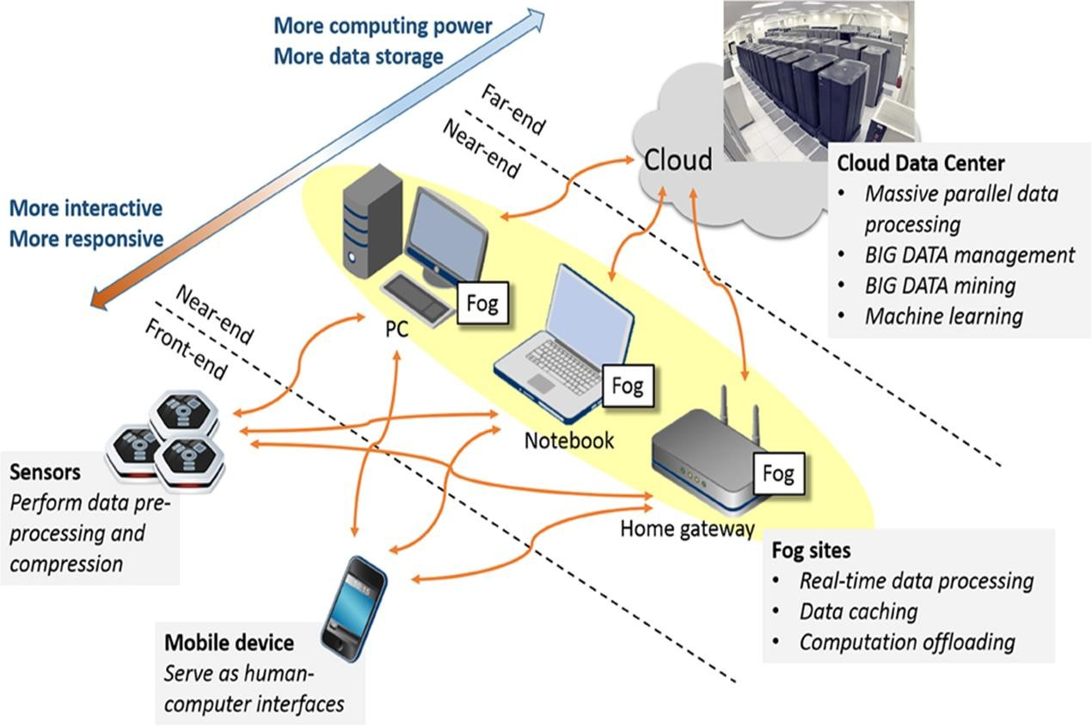
Fog Computing

Slide 9
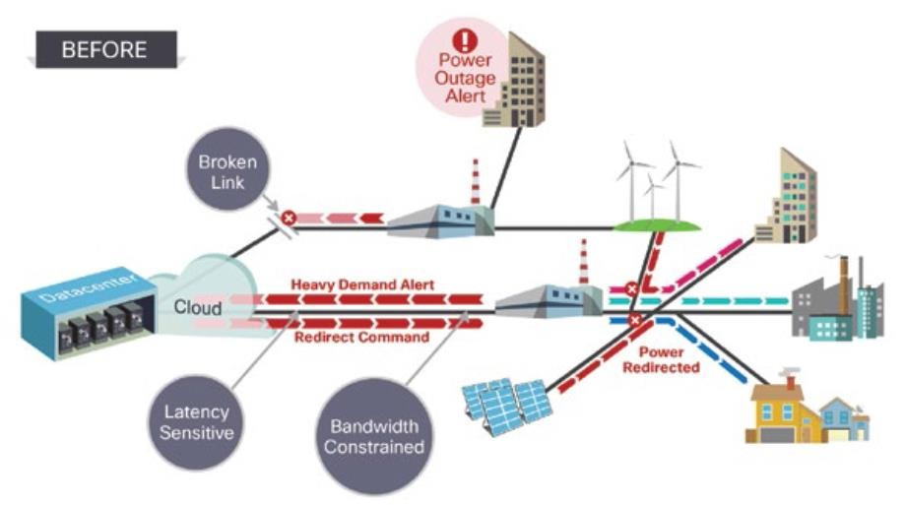
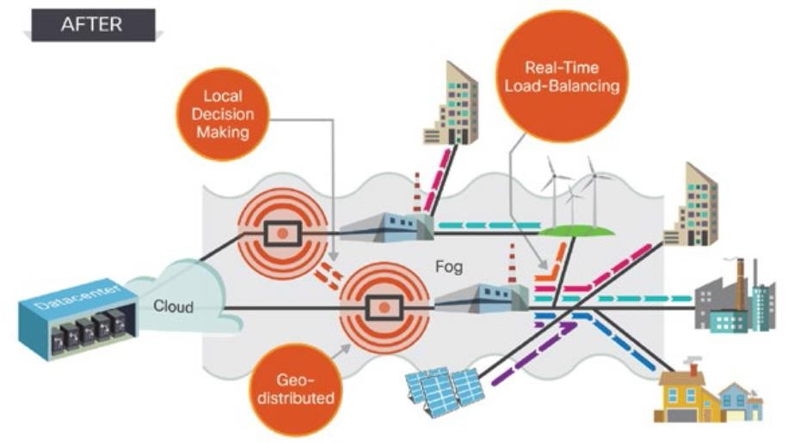
Fog Computing: Before & After
Cloud architecture before the advent of fog technology
Cloud architecture with the advent of fog technology

Slide 10
Fog Computing Characteristics
Geographical
distribution
The services and application objective of the fog is widely
distributed.
Support for mobility
Fog devices provide mobility techniques like decouple host identity to location identity.
Real time interactions
Fog computing requires real time interactions for speedy service.
Heterogeneity
Fog nodes can be deployed in a wide variety of environments.
Fog components must be able to interoperate in order to give wide range of services like streaming.
Interoperability

Slide 11
FOG VS. CLOUD
Reduction in data movement across the network resulting in reduced congestion.
Elimination of bottlenecks resulting from centralized computing systems.
Improved security of encrypted data as it stays closer to the end user.

Slide 12
Fog VS. Cloud
Requirement | Cloud Computing | Fog Computing
Latency | High | Low
Delay Jitter | High | Very Low
Location of Server Nodes | With in Internet | At the edge of local n/w
Distance between the client and server | Multiple Hops | One Hop
Security | Undefined | Can be Defined
Attack on data enrouter | High Probability | Very Less Probability
Location Awareness | No | Yes
Geographical Distribution | Centralized | Distributed
No. of server nodes | Few | Very Large
Support for Mobility | Limited | Supported
Real time interactions | Supported | Supported
Type of last mile connectivity | Leased line | Wireless

Slide 13
FOG COMPUTING & INTERNET OF THINGS
By 2020, the number of “things” that are part of the IoT may reach up to 50 billion. That’s a lot of data being generated.

Slide 14
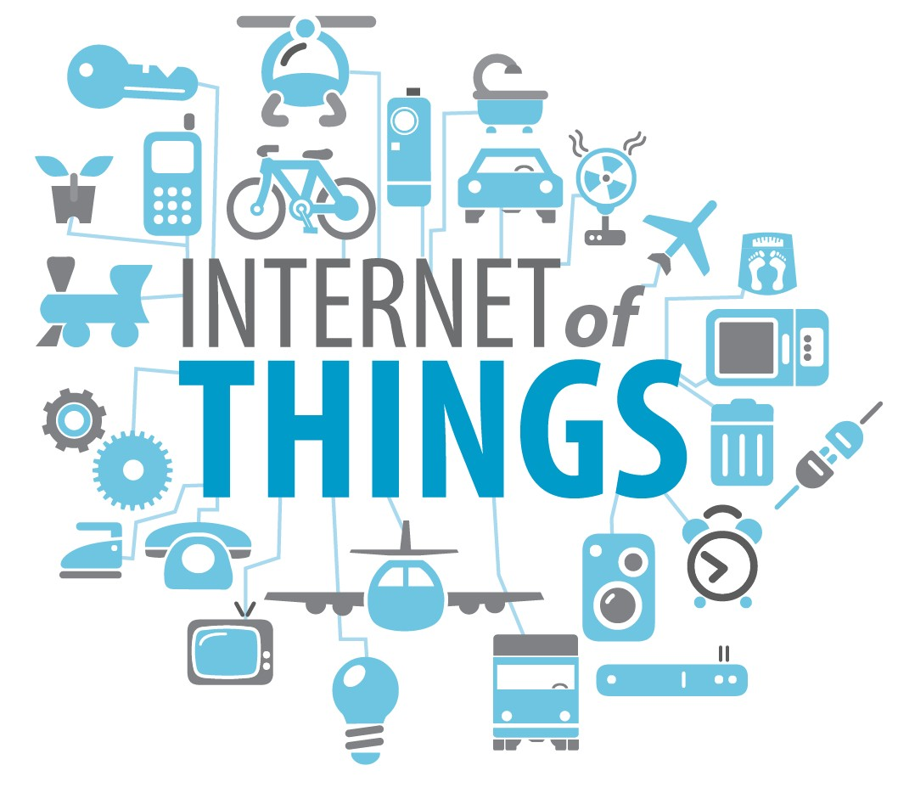
Internet of Things (IoT)
The Internet of Things (IoT) is the network of physical objects devices, vehicles, buildings and other items embedded with electronics, software, sensors, and network connectivity that enables these objects to collect and exchange data.

Slide 15



Fog Computing Architecture
IoT Applications
Application Models
Sense-Process-Actuate Resource Provisioning and
Operator Placement
Stream Processing
Resource Management
Scheduling
Infrastructure Monitoring
Monitoring
Performance
Prediction
Knowledge
Base
Data Generated
Data Streams
Fog Devices
IoT Sensors and Actuators

Slide 16
Fog Computing Architecture
IoT Sensors:
Are placed at the bottommost layer of the architecture and distributed geographically, sensing the environment, and emitting observed values to upper layers via gateways for further processing and filtering.
IoT Data Streams are made of a sequence of immutable values emitted by sensors.
IoT Actuators:
Similarly operate at the bottommost layer of the architecture and are responsible for controlling a mechanism or system. Actuators are usually designed to respond to changes in environments that are captured by sensors.
Fog Device:
In the architecture any element in the network that is capable of hosting application modules is called Fog Device. Fog devices that connect sensors to the Internet are generally called gateways.

Slide 17
Fog Computing Architecture
In addition, the architecture defines three main services for Fog and IoT environments that are described below:
Monitoring Components:
Keep track of the resource utilization and availability of sensors, actuators, Fog devices and network elements. They keep track of the applications and services deployed on the infrastructure by monitoring their performance and status. Monitoring components supply this information to other services as required.
Resource Management:
Is the core component of the architecture and consists of components that coherently manage resources in such a way that application level QoS constraints are met and resource wastage is minimized. To this end, Placement and Scheduler components play a major role by keeping track of the state of available resources to identify the best candidates for hosting an application module.

Slide 18
Fog Computing Architecture
Power Monitoring:
One of the toughest challenges that most IoT solutions face is utilization of resources of
IoT nodes while considering constraints on energy consumption.
In contrast to cloud data centers, Fog computing encompasses a large number of devices with heterogeneous power consumption, making energy management difficult to achieve.

Slide 19
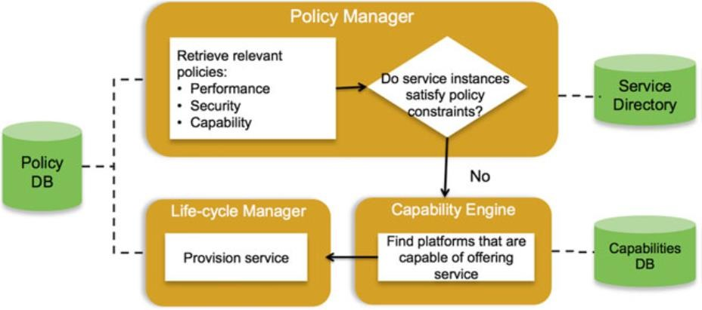
Fog & Policy Management
Policy based orchestration framework of fog technology

Slide 20
How Does Fog Work?
Developers either port or write IoT applications for fog nodes at the network edge.
The fog nodes closest to the network edge ingest the data from IoT devices. Then the fog IoT application directs different types of data to the optimal place for analysis, as shown in Table:
 | Fog Nodes Closest to IoT Devices | Fog Aggregation Nodes | Cloud
Response time | Milliseconds to sub second | Seconds to minutes | Minutes, days, weeks
Application examples | M2M communication, including telemedicine and training | Visualization Simple analytics | Big data analytics Graphical dashboards
How long IoT data is stored | Transient | Hours, days, or weeks | Months or years
Geographic coverage | Very local: for example, one city block | Wider | Global

Slide 21
What Happens in the Fog and the Cloud?
Fog nodes
Receive feeds from IoT devices using
any protocol, in real time.
Run IoT-enabled applications for real- time control and analytics, with millisecond response time.
Provide transient storage, often 1–2 hours.
Send periodic data summaries to the
cloud.
Cloud platform
Receives and aggregates data
summaries from many fog nodes.
Performs analysis on the IoT data and data from other sources to gain business insight.
Can send new application rules to the fog nodes based on these insights.

Slide 22
CASE STUDY
Fog Computing in Healthcare: A Review and Discussion

Slide 23

Challenges For Healthcare
Healthcare systems in most countries face enormous challenges that will increase due to aging population and the rise of chronic diseases.
Growing nursing staff shortage.
Much time is wasted in hospitals by manually measuring biometric parameters and transferring the data between systems.

Slide 24
Requirements of Healthcare Applications
Bandwidth Latency
Energy-Efficiency Dependability
Security Interoperability
require a bandwidth of at least 20.48 kbit/s and 96 kbit/s.
A192-leadEEGcan demand 921.6 kbit/s bandwidth.
For ECG, latencies of up to 2 to 4 seconds in real-time monitoring are acceptable.
some in-body sensors rely on energy-harvesting, either by heat or kinetic energy.
some sensors may require an operation of the patient when battery needs replacement.
Depending on what data is used for, system failures have different consequences, from minor inconvenience to serious threat to the patients’ lives.
the security requirements in healthcare are high.
Systems, even when provided by different vendors, should be interoperable with each
other.

Slide 25
The Vision of Fog Computing in Healthcare
Flexibility of Computation locus:
The location can be dynamic and depend on the current context, environment and application requirements.
Integration:
Within fog computing architecture, new sensors can be added to the existing infrastructure.
Fog computing can also serve as a compatibility layer to translate between various standards.
Patient mobility:
Application-speciﬁc infrastructure also limits the area where patients can be monitored.
the transitions between different environments can be managed more gradually.
New Applications:
Fog computing will provide latency and response time improvements, as well as energy
savings for wearable and low-cost devices, while performing complex tasks such as fall
detection.
Internet of Health care things.

Slide 26
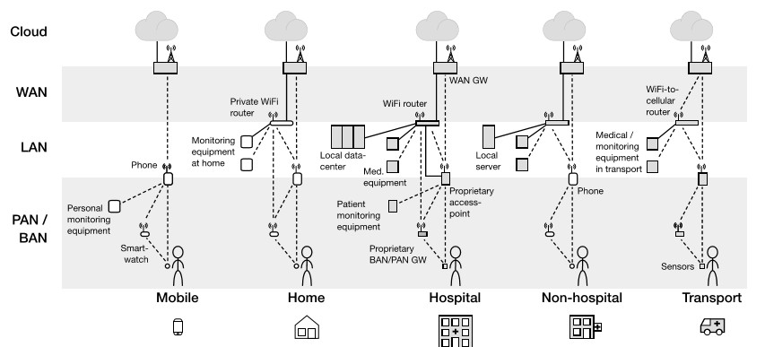
Health Applications: Without Fog

Slide 27
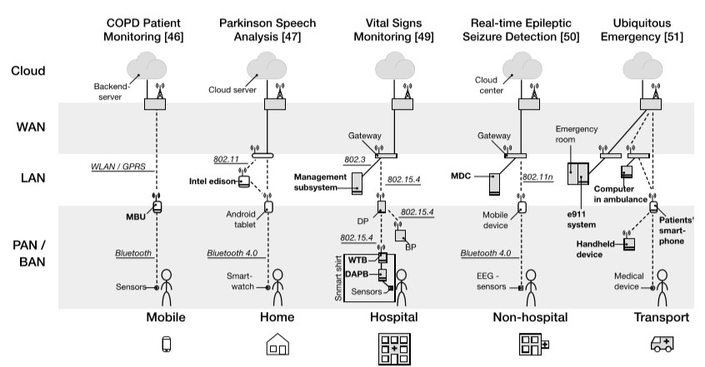
Health Applications: With Fog

Slide 28
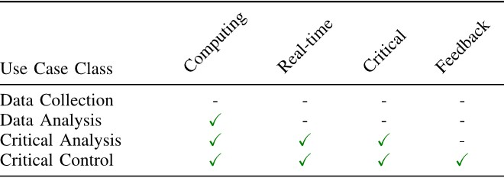
Use Case Classes

Slide 29




























































































FURTHER
APPLICATIONS
Tech giants Cisco and IBM are the driving forces behind fog computing, and link their concept to the emerging Internet of Things (IoT).
According to Cisco, the important areas where fog would play a vital role
are the following:

Slide 30
Fog Computing Applications
Connected Cars:
Fog computing is ideal for Connected Vehicles because real-time interactions will make communications between cars, access points and traffic lights as safe and efficient as possible.
Fog computing will be the best option for all internet connected vehicles because fog computing gives real time interaction.

Slide 31
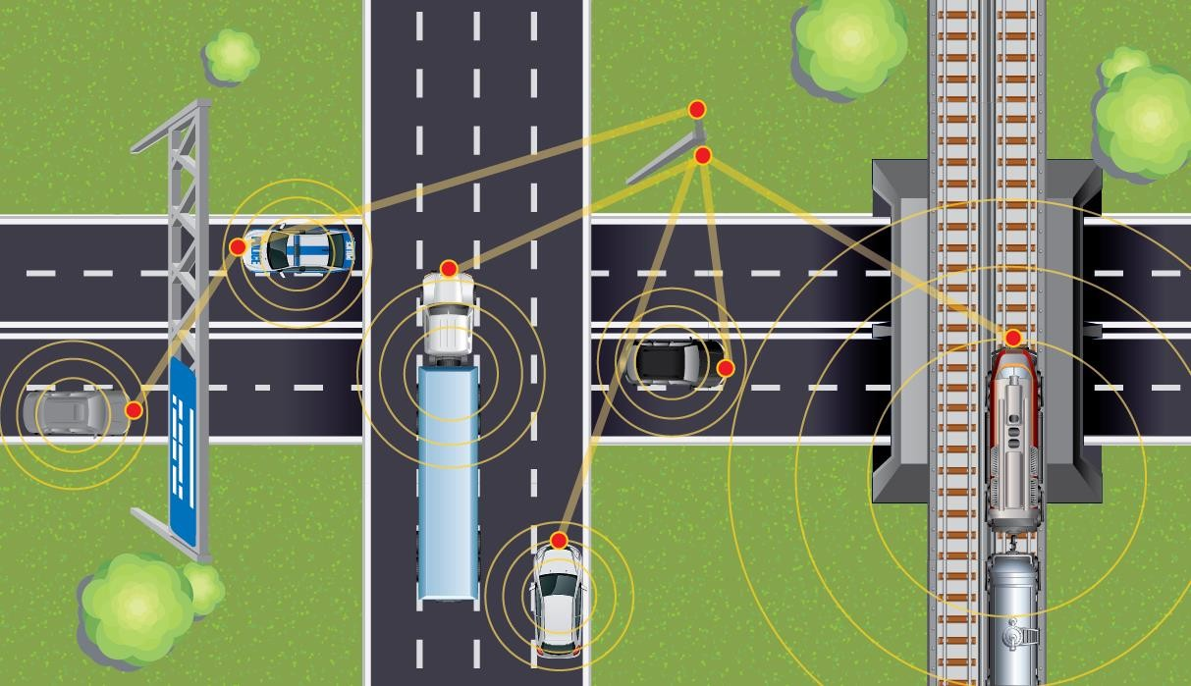
Fog Computing Applications
Connected Vehicles communicating each other

Slide 32
Fog Computing Applications
Smart Grids:
Fog computing allows fast, machine-to-machine (M2M) handshakes and human to
machine interactions (HMI), which would work in cooperation with the cloud.
Based on demand for energy, its obtainability and low cost, these smart devices can switch to other energies like solar and winds. The edge process the data collected by fog collectors and generate control command to the actuators. The filtered data are consumed locally and the balance to the higher tiers for visualization, real-time reports and transactional analytics.
Fog supports semi-permanent storage at the highest tier and momentary storage at the
lowest tier.

Slide 33
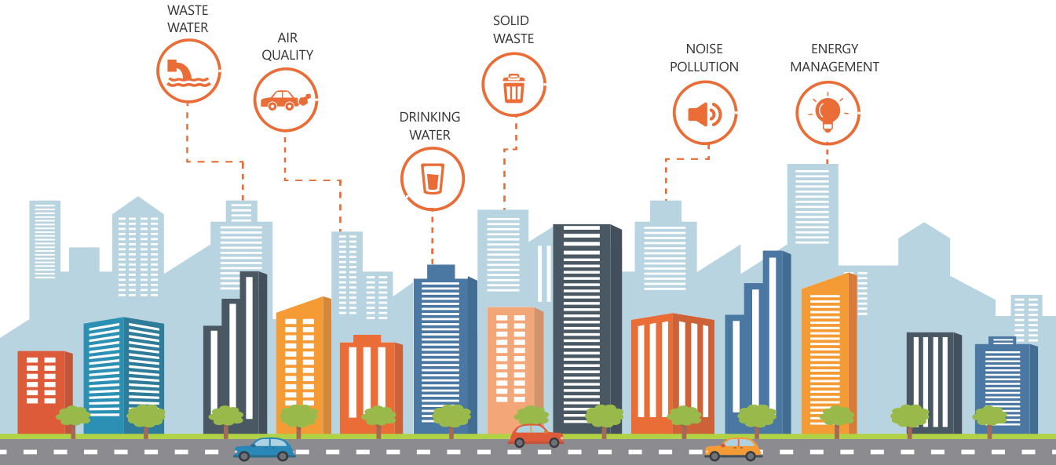
Fog Computing Applications
Smart Cities:
Fog computing would be able to obtain sensor data on all levels, and integrate all the
mutually independent network entities within.

Slide 34
Fog Computing Milestones
Author & Year | Techniques & Parameters | Advantages | Limitations
Salvatore J. Stolfo (2012) | Detect abnormal data access patterns, User Behavior Profiling | Securing data in the cloud using offensive decoy technology | Unprecedented levels of security in the Cloud and in social networks
Jiang Zhu (2013) | Web optimization, webpage rendering performance, webserver or CDNs | Web optimization applied in a novel manner, various methods can be combined with unique knowledge that only available at the edge nodes | Feasibility and optimization needed
Luis M. Vaquero (2014) | Network Function Virtualization (NFV), peer-to-peer (P2P), Internet of Things (IoT), Sensor networks, Cloud computing, Configuration management | It offers a comprehensive definition of the fog, comprehending technologies as diverse as cloud, sensor and P2P networks, network virtualization functions or configuration management techniques | Integration of various technologies into a single IT scenario is an answer to new requirements introduced by device ubiquity and demands for agile network and service management and privacy but it’s not a simple work and time consuming process.
Tom H. Luan (2016) | Cloud based internet, proliferation, agility of service, real time response, long thin connection | Outline the main features of Fog computing and describe its concept, architecture and design goals. | Issues on network management, traffic engineering, big data and novel service delivery

Slide 35
Summary
Fog computing gives the cloud a companion to handle the two exabytes of data generated daily from the Internet of Things. Processing data closer to where it is produced and needed solves the challenges of exploding data volume, variety, and velocity.
Fog computing accelerates awareness and response to events by eliminating a round trip to the cloud for analysis.
It avoids the need for costly bandwidth additions by offloading gigabytes of network traffic from the core network. It also protects sensitive IoT data by analyzing it inside company walls. Ultimately, organizations that adopt fog computing gain deeper and faster insights, leading to increased business agility, higher service levels, and improved safety.

Slide 36
References
IJRET: Fog Computing: Beginning of a New Era in Cloud Computing, e-ISSN: 2395 - 0056 | p-ISSN: 2395-0072 (2017)
https://www.researchgate.net/publication/317009776_Fog_Computing_Beggining_of_a
_New_Era_in_Cloud_Computing?ev=srch_pub
Fog Computing and Internet of Things: Extend the cloud to where the things are
(2015)
http://www.cisco.com/c/dam/en_us/solutions/trends/iot/docs/computing-overview.pdf
Fog Computing in Healthcare – A Review and Discussion, DOI: 10.1109 |
ACCESS.2017.2704100 (2017)
https://www.researchgate.net/publication/316946904

Slide 37
FOGGY FUTURE
Cloud computing has quickly gained mainstream adoption... but fog computing has the potential to be just as dominant, if not more so.

